Slide 1



Lesson 1: The Basics
<Web />
Front-end
Development
University of Tehran
Lecturer:
Misagh Mohaghegh
ACM
Summer of Code 2024

Slide 2

Certificate
In order to get the course certificate:
You can at most not attend 4 of the course classes (out of 12).
You need to get at least 70% of the homework scores.

Slide 3
Prerequisites
Have some basic programming knowledge.
Get familiar with VSCode.
Get familiar with Git & GitHub.

Slide 4










Prerequisites
Have some basic programming knowledge.
Get familiar with VSCode.
Get familiar with Git & GitHub.

Slide 5
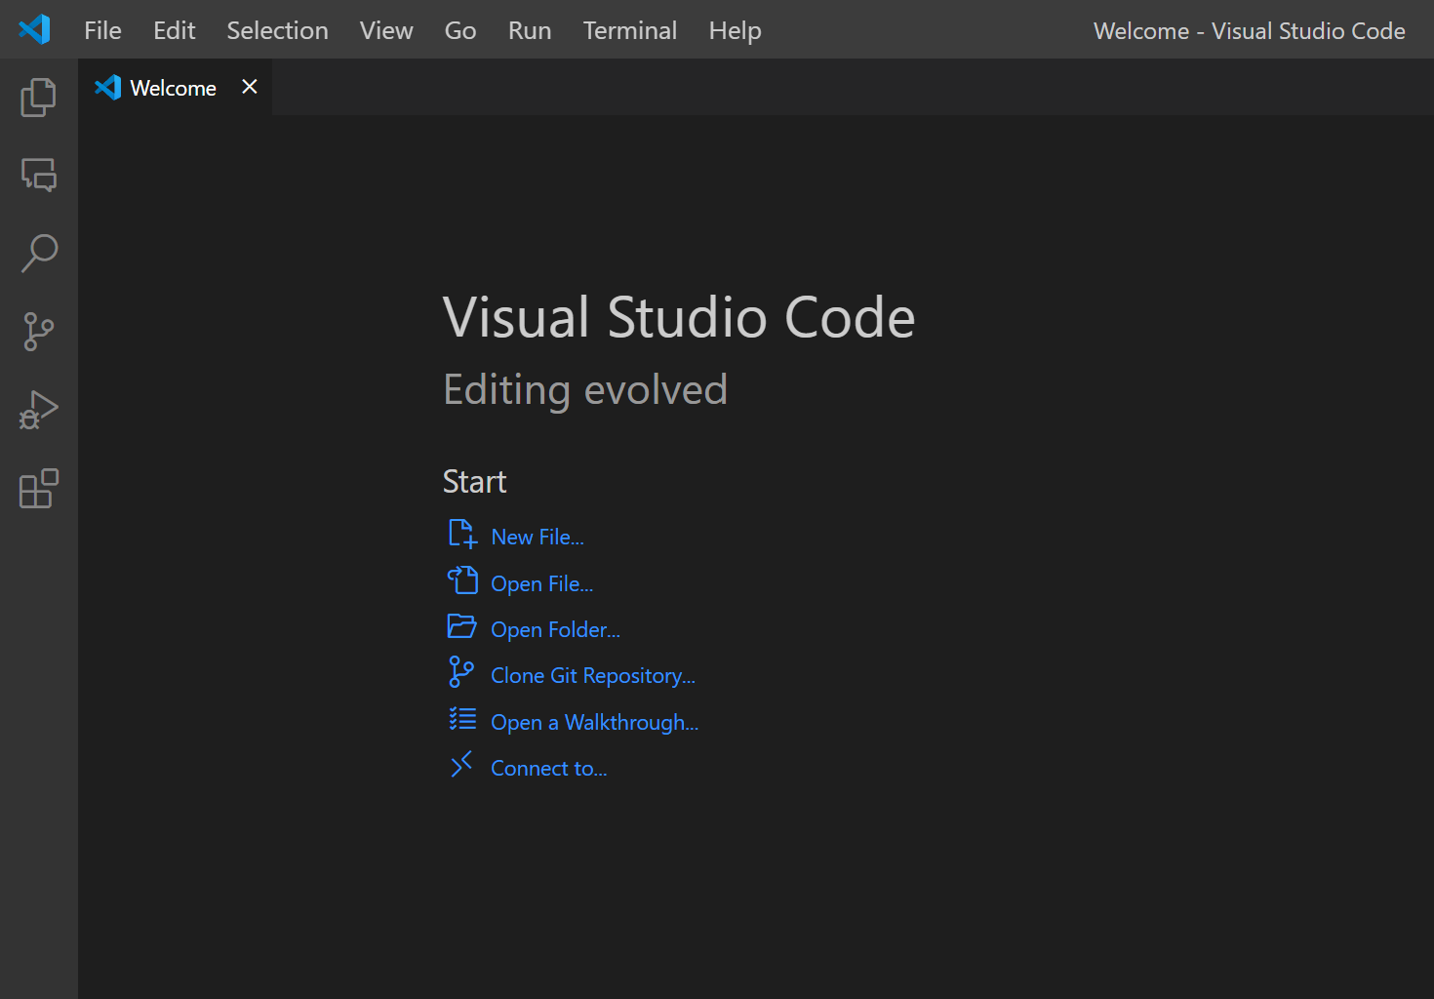

Prerequisites
Have some basic programming knowledge.
Get familiar with VSCode.
Get familiar with Git & GitHub.

Slide 6
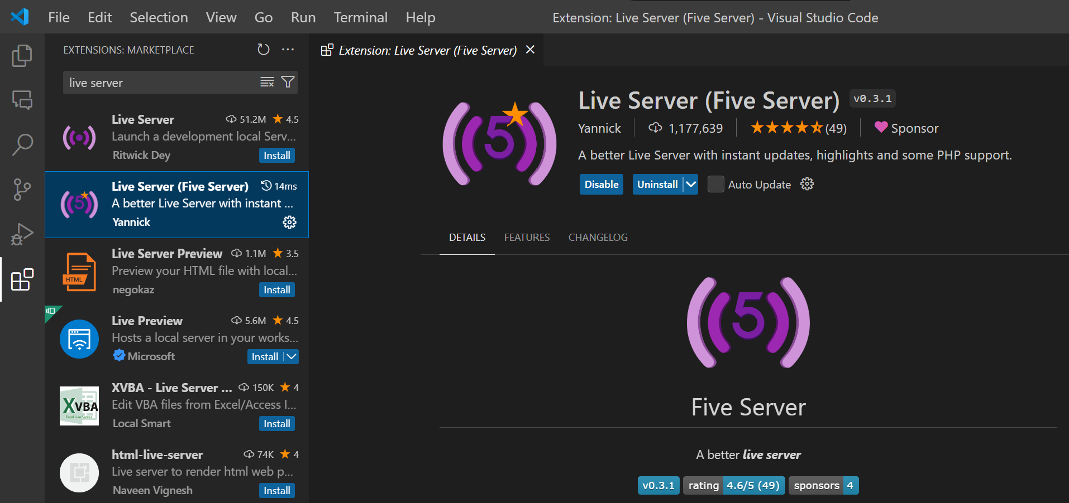
Prerequisites
VSCode Extension:

Slide 7
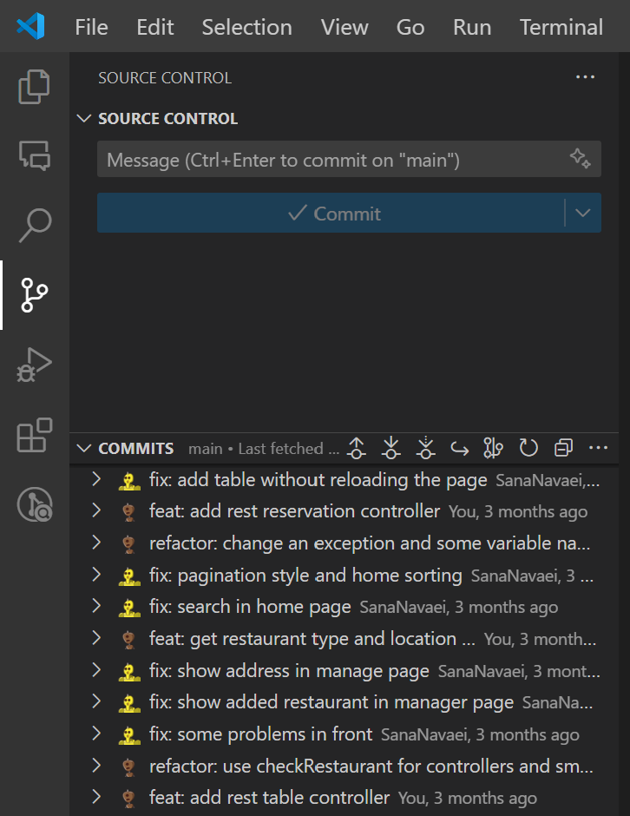


Prerequisites
Have some basic programming knowledge.
Get familiar with VSCode.
Get familiar with Git & GitHub.

Slide 8




Prerequisites
Have some basic programming knowledge.
Get familiar with VSCode.
Get familiar with Git & GitHub.
Search search search!

Slide 9

UI/UX Designer vs Front-end Developer
UI: User Interface
UX: User Experience

Slide 10
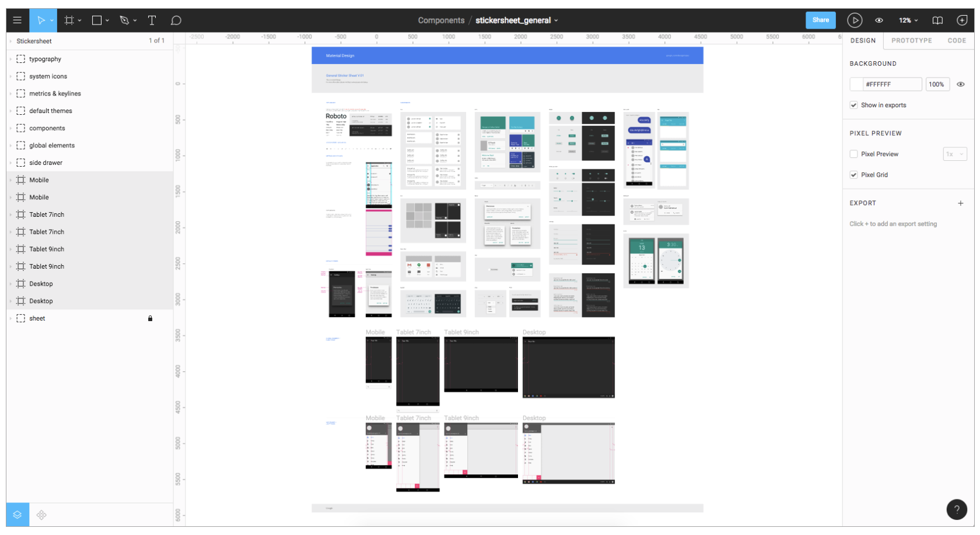
Figma, a tool for designers

Slide 11







Welcome to the course!
Web Basics
HTTP Protocol
(Hypertext Transfer Protocol)
HTML
(Hypertext Markup Language)
CSS
(Cascading Style Sheets )
Bootstrap
JS
(JavaScript)
React

Slide 12
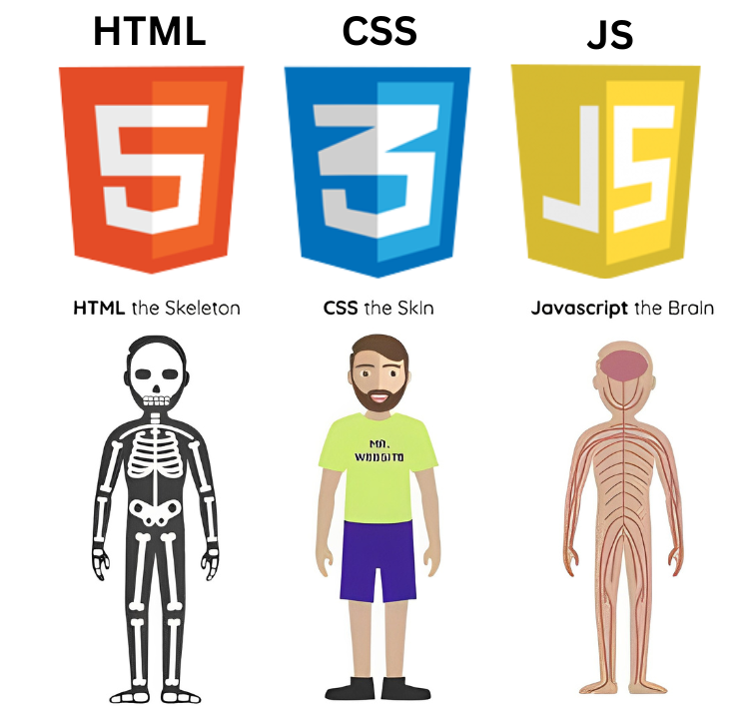
The Building Blocks

Slide 13
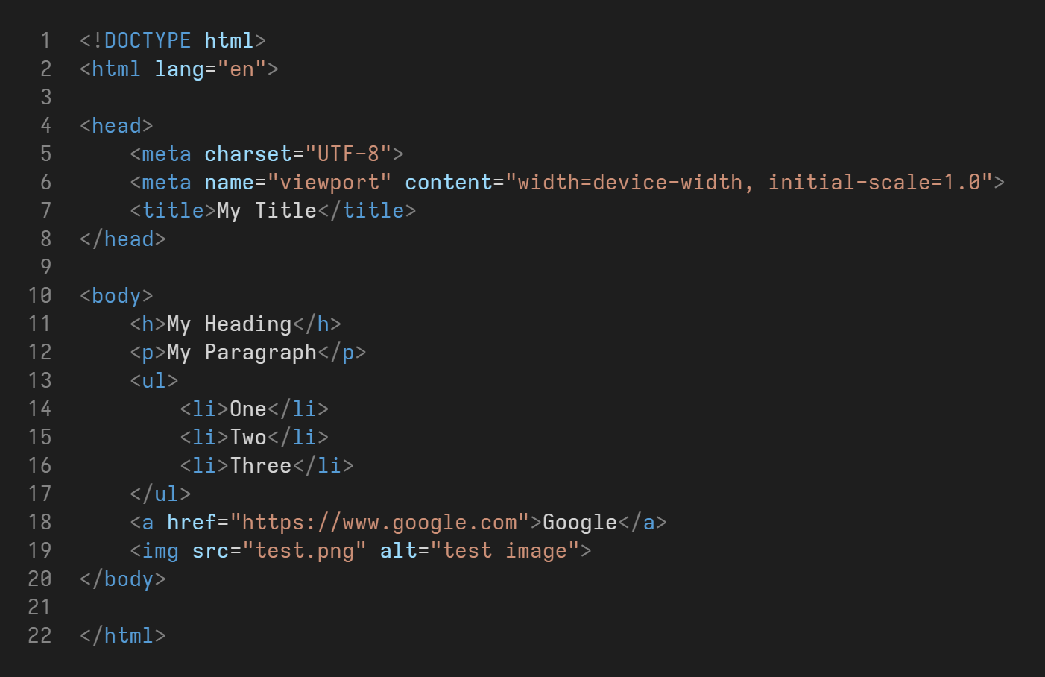
The Building Blocks

Slide 14
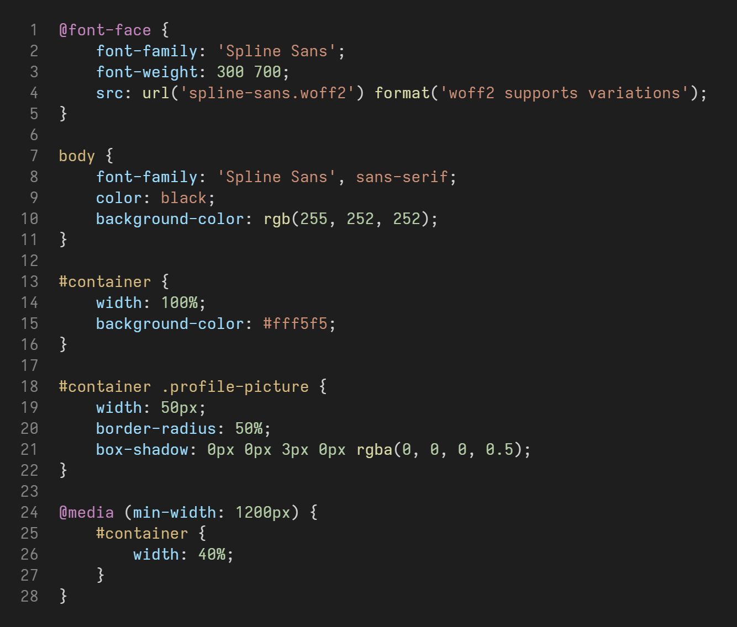
The Building Blocks

Slide 15
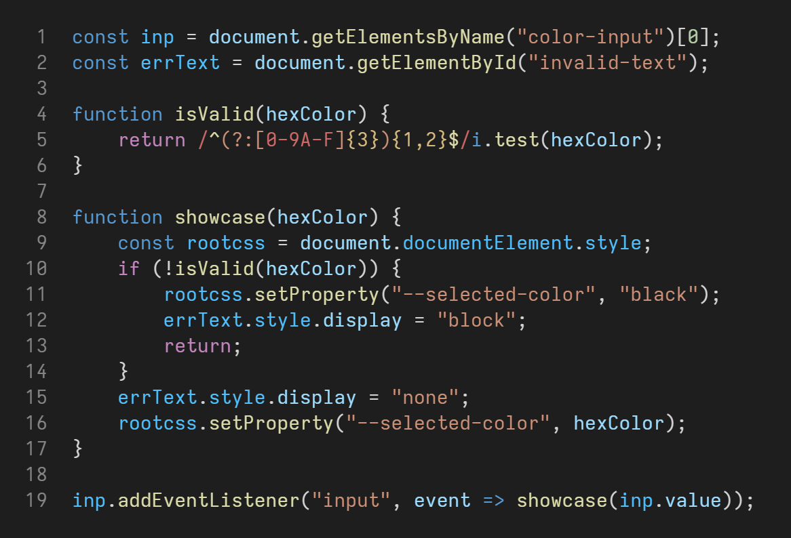
The Building Blocks

Slide 16
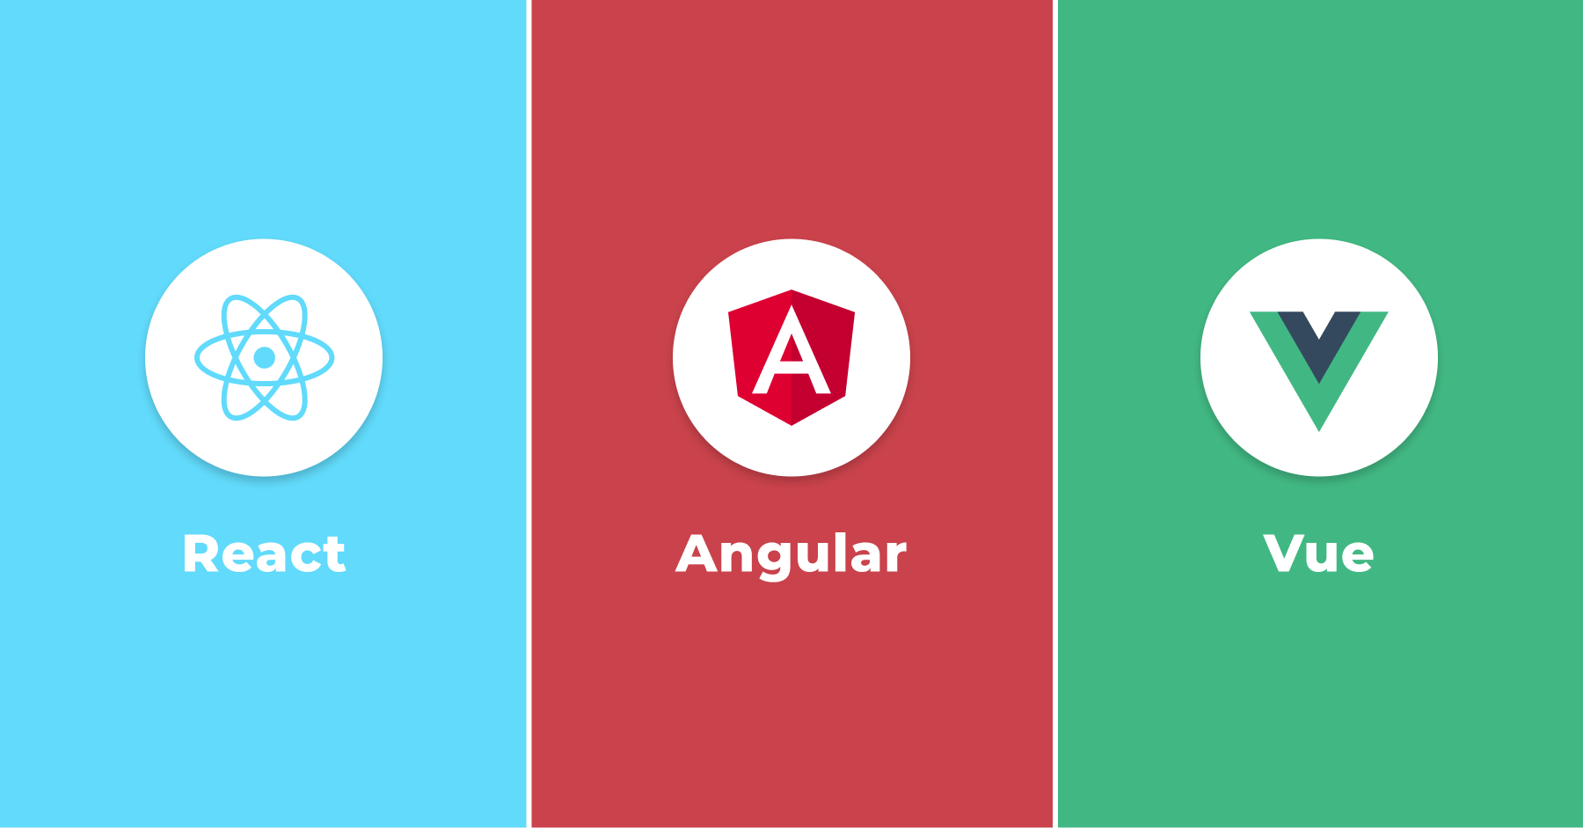
JavaScript Frameworks

Slide 17
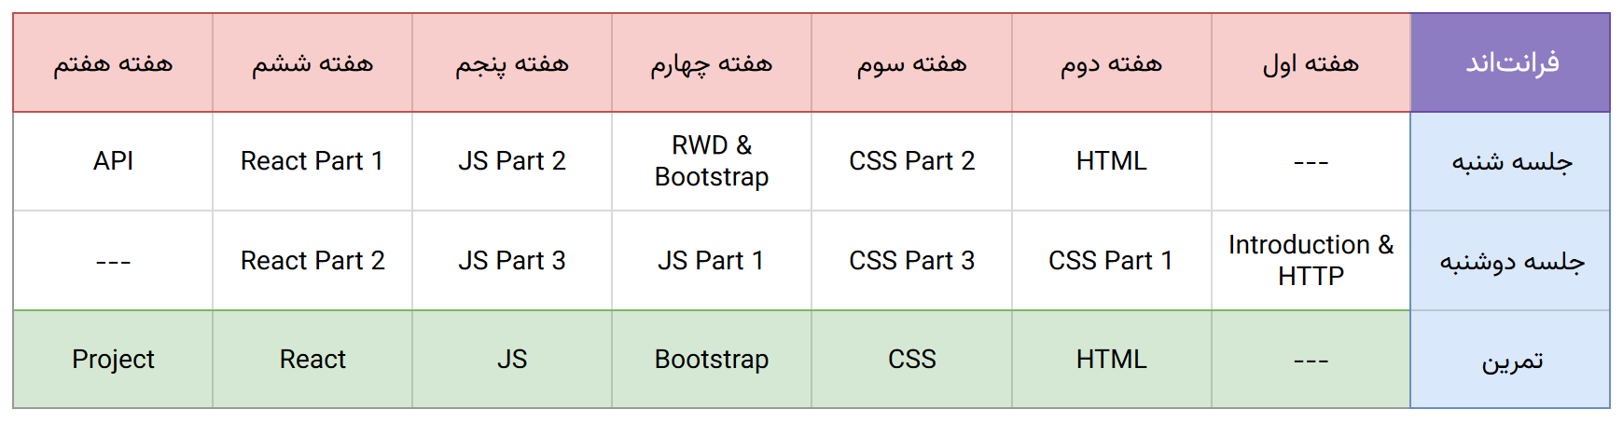
Schedule

Slide 18
HTTP Protocol

Slide 19
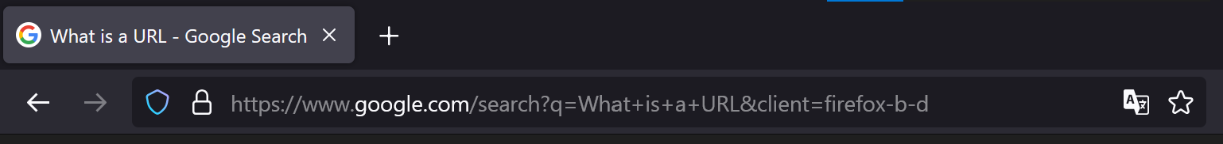
URL (Uniform Resource Locator)
Protocol
Scheme
Domain
Query 1: q
https://www.google.com/search?q=What+is+a+URL&client=firefox-b-d
Subdomain
Path
Query 2: client

Slide 20
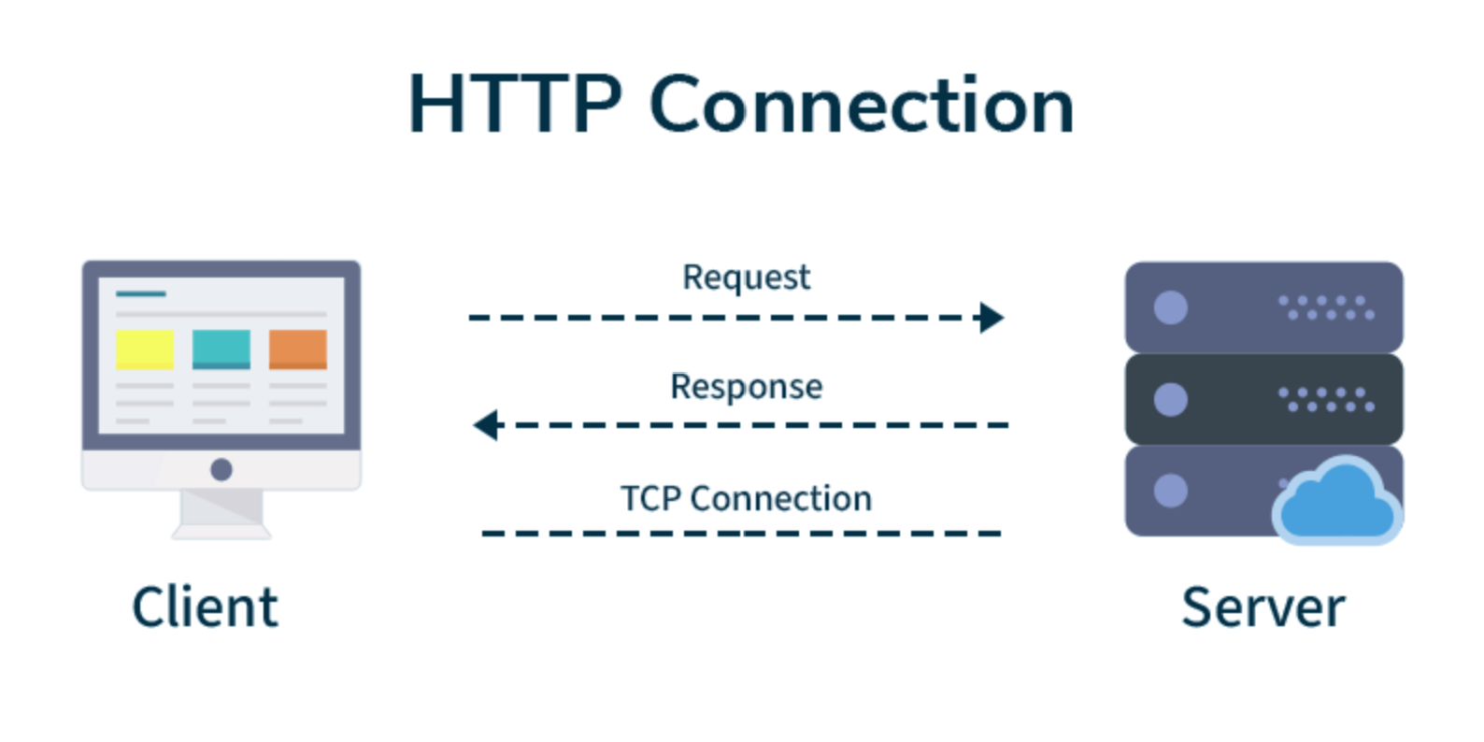
HTTP (Hypertext Transfer Protocol)
1
Hypertext Transfer Protocol
The foundation of data communication in the World Wide Web.
Defines how messages are formatted and transmitted.
2
Client-Server Model
A client (the web browser) initiates a HTTP request to a server.
The server sends a response back to the client.
3
Stateless Protocol
Each request is made independent of previous requests.

Slide 21




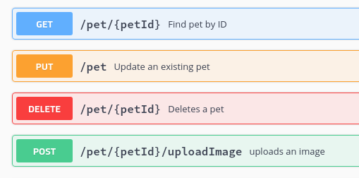
HTTP Request
There are 9 HTTP request methods.
The most used ones are:
GET
POST
PUT
DELETE
Retrieve data from the server.
Send new data to the server.
Update data on the server.
Remove data from the server.
Example back-end API accepted
HTTP request method and paths:

Slide 22
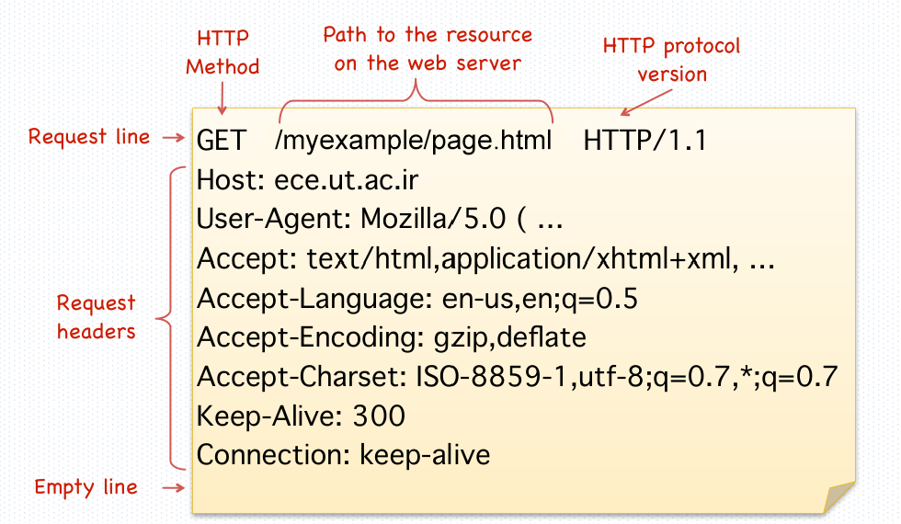
Raw HTTP Request

Slide 23
HTTP Response
There are 5 types of response status codes:
1xx – Informational
These indicate that the request was received and the server is processing it.
2xx – Successful
These indicate that the request was successfully received, understood, and accepted.
3xx – Redirection
These indicate that further action needs to be taken by the client to complete the request.
4xx – Client Error
These indicate that the client has made an error, such as a bad request or unauthorized access.
5xx – Server Error
These indicate that the server has failed to fulfill a valid request.

Slide 24
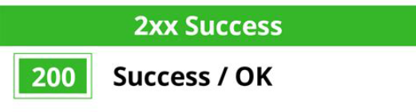
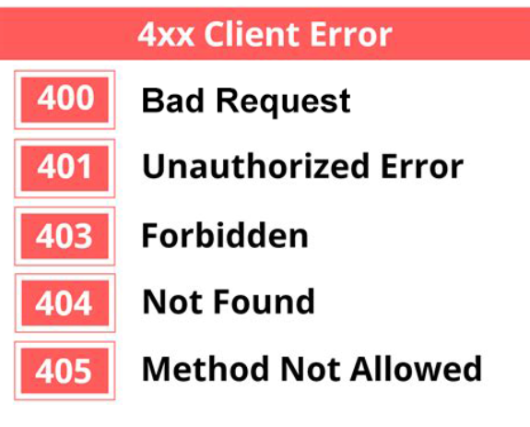
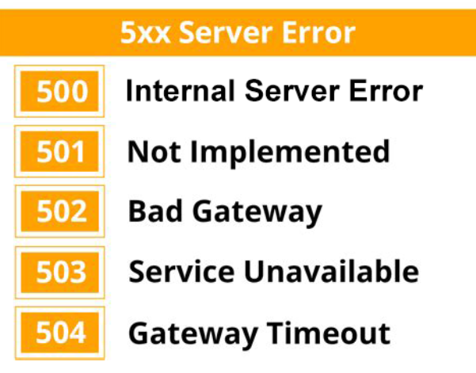
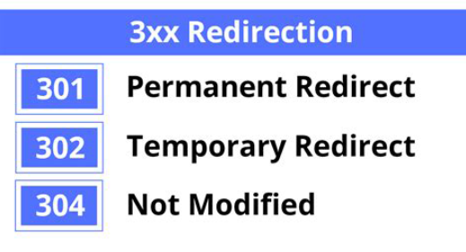
HTTP Response

Slide 25
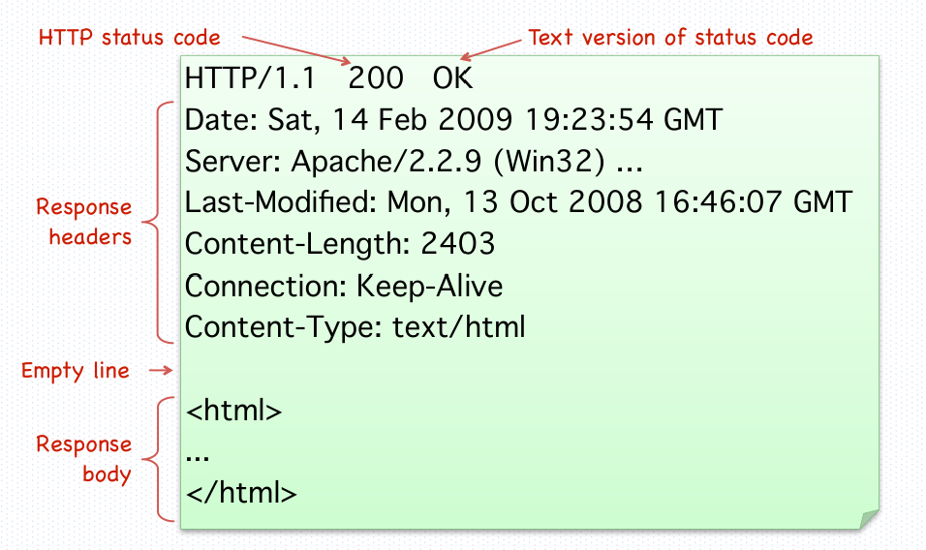
Raw HTTP Response

Slide 26
Thank you for your attention.

